Slide 1

WAB Tiger Commerce
WAB DAD| Parent Link Project 2018/19
Jim James
jimajames@icloud.com
Issue: 12.09.2018 v5

Slide 2
1. Current situation
Parent Link sells WAB Tiger merchandise at one shop.
The Tiger Den is located in WAB’s Elementary school.
Volunteers run the shop.
Shopping hours are limited.
Tiger plays valuable role in the community
Legal and financial aspects held by WAB

Slide 3
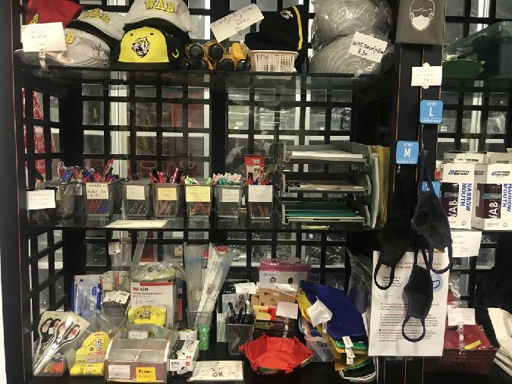
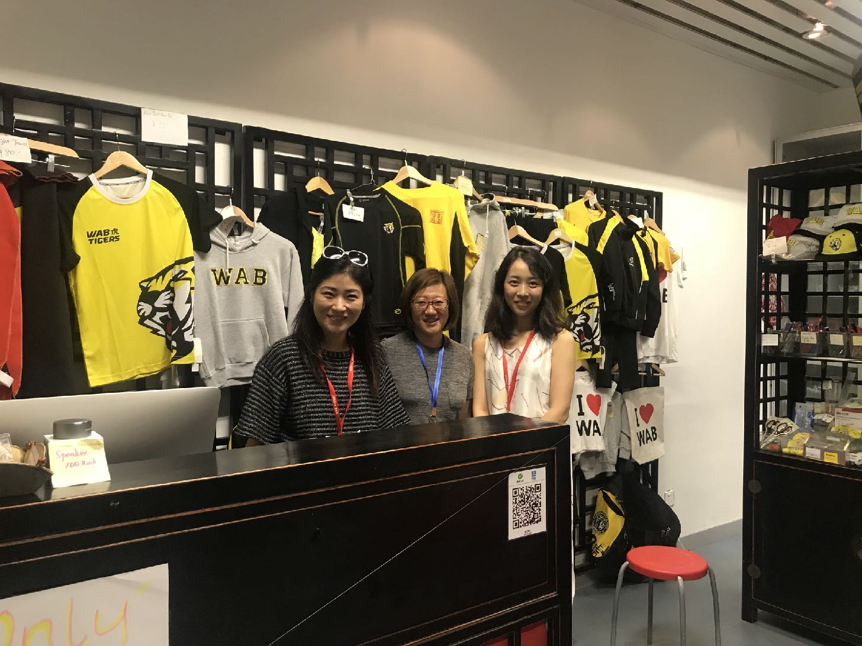
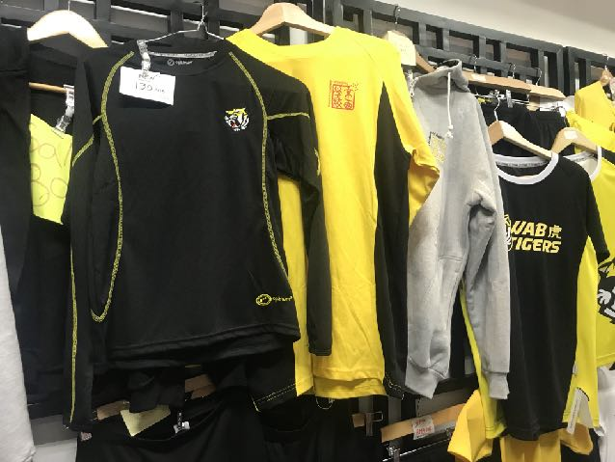
The Tiger Den: Community shop
Monday, Tuesday, Thursday, Friday 08:30-11:30 Wednesday 12:30 - 3:10

Slide 4
2. Objectives
Offer WAB Tiger merchandise to customers 24/7
Increase WAB Tiger merchandise sales contribution to Parent Link
Reduce the work load on the shop volunteers
Enable WAB Alumnus to continue to support WAB
Reduce costs of WAB Tiger merchandise by increasing volume
Develop new WAB merchandise

Slide 5
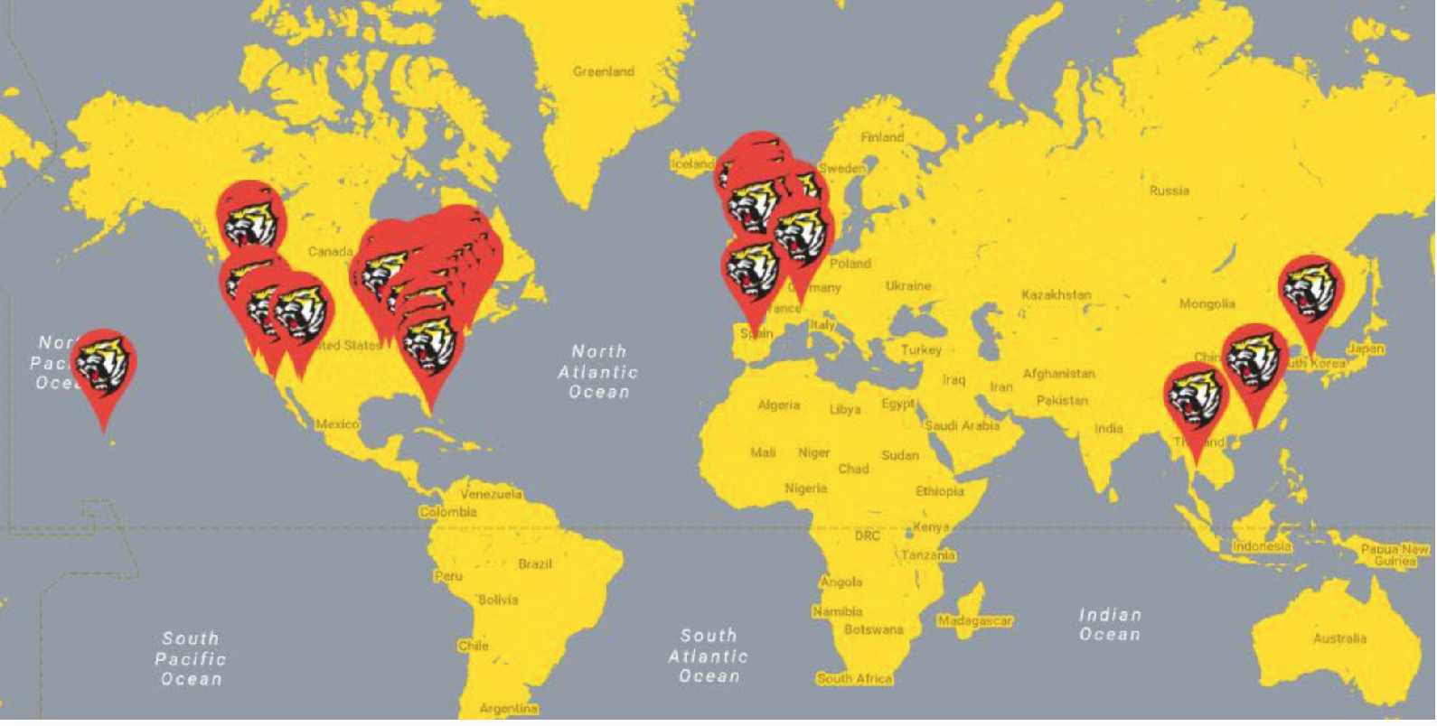
Target customers
Current students, families, and 5,000+ WAB Alumni Network worldwide
Potential market for WAB Tiger merchandise:

Slide 6
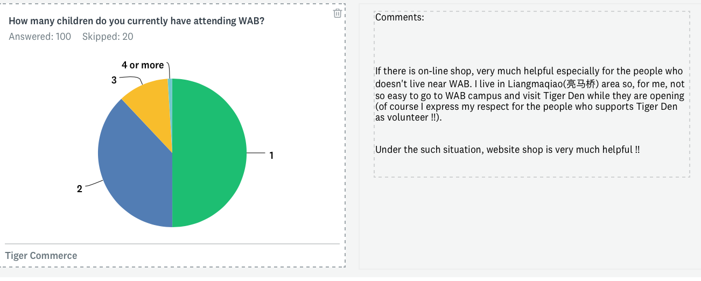
1. 71% of respondents have visited the Tiger Den.
2. 9% say that they are a ‘great deal’ familiar with the products available
3. 63% have made purchases from the Tiger Den.
4. 38% would definitely make a purchase online
5. 45% spend over RMB150 per year
6. 59% purchase each semester
3. The current situation
On-line Survey with 100 respondents who answered anonymously to a general call to answer 10 questions. Closed 12.09.2018

Slide 7
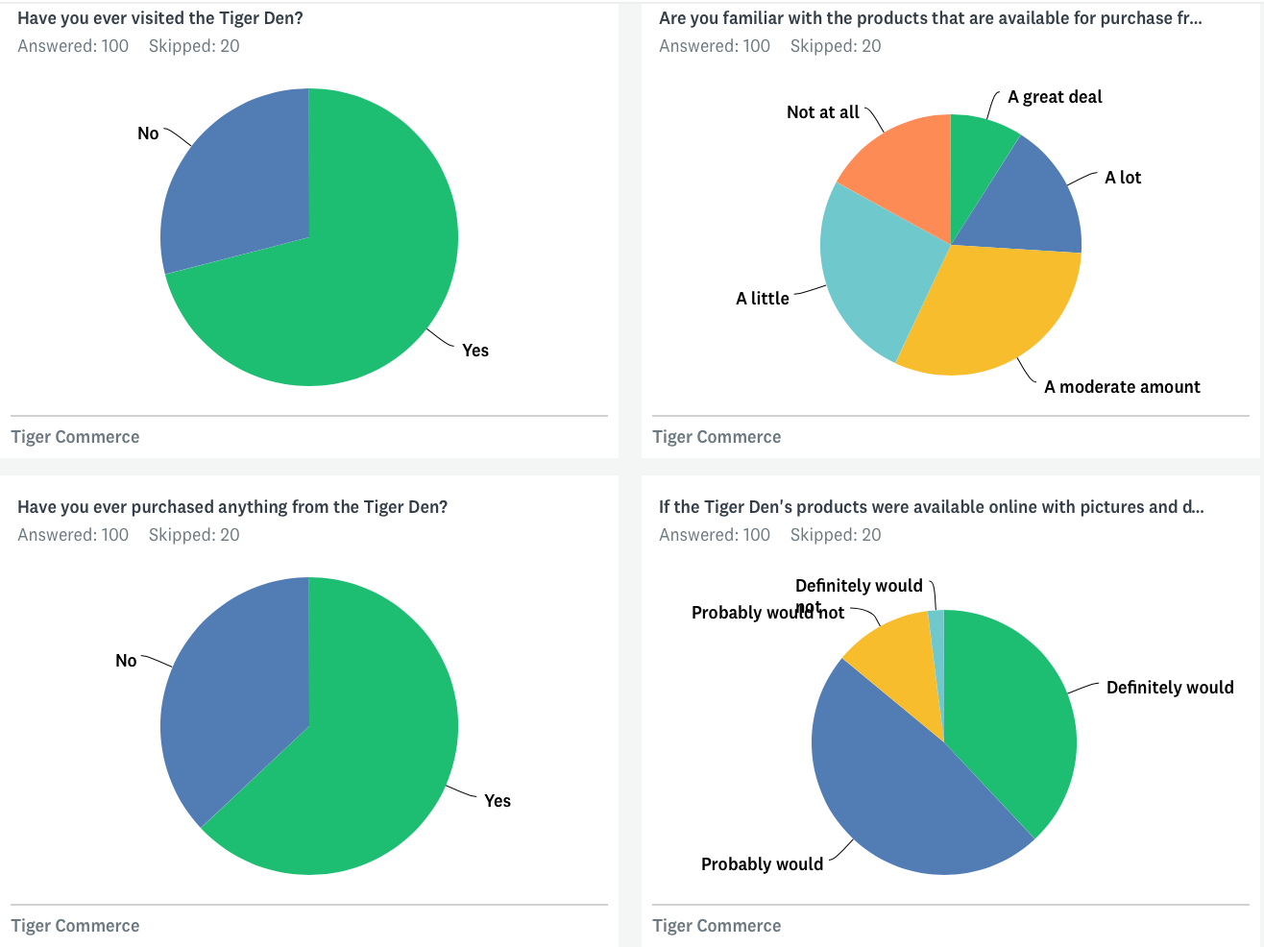
A demand for WAB merchandise availability both on and offline.
Are you familiar with the products that are available for purchase from the Tiger Den?
If the Tiger Den's products were available online with pictures and descriptions, would you visit the e-commerce site?
Survey with 100 respondents who responded to a general call to answer 10 questions.

Slide 8
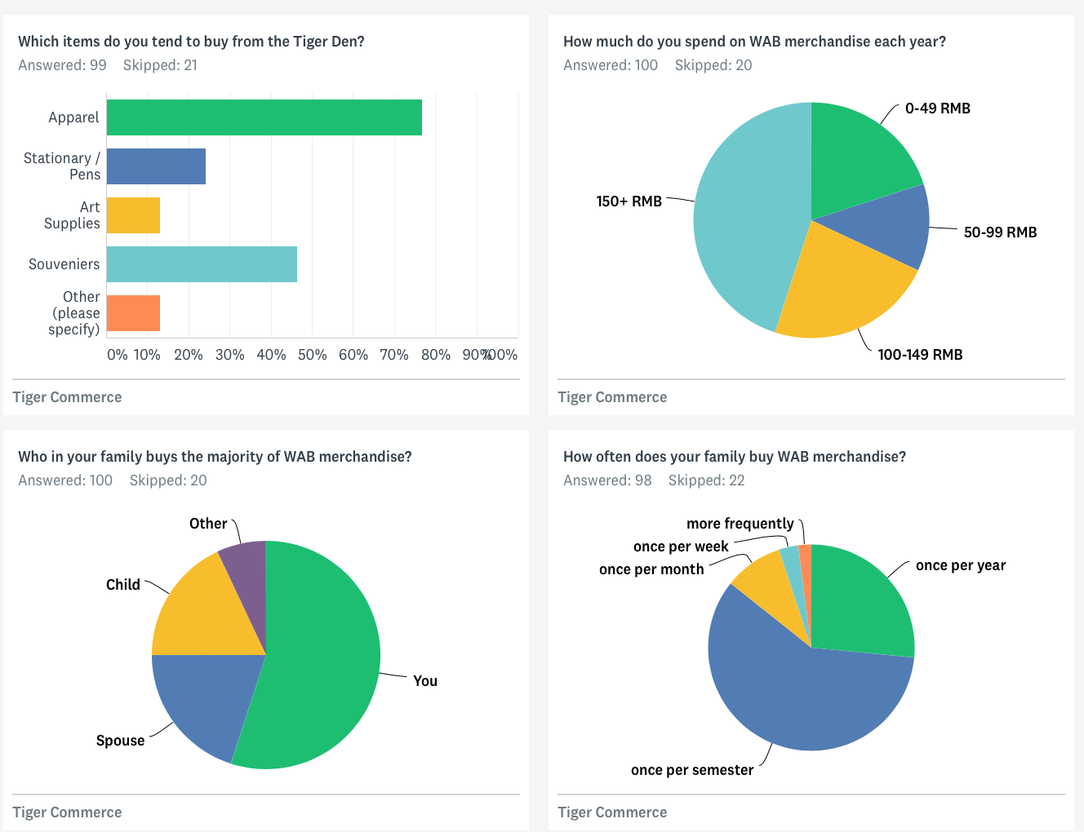
Tiger Den as key outlet for WAB apparel.
120 responded, only 100 answers shown due to software license restrictions.

Slide 9


WAB Tiger Merchandise
Currently the store sells:
- WABX apparel
- WAB marketing stock
- Tiger Den developed products
- Student developed products
- Cambridge Masks
- Miscellaneous items e.g. keyboard covers, USB, school supplies, lanyard
Survey respondents also requested:(no order)
Umbrellas, decorations, decals. Folders. Highlighters. Caps. Wab polo tees, boxer shorts, tiger shark swimming trousers, T-shirt, socks, schoolbag, mac notebook cover, red fleece WAB blanket, pencil bag, WAB swimwear, WAB beanie for adults, USB’s, caps, coasters, drink coolers: the things you put your bottles or cans in to keep cool. Car stickers (bumper) screen shades for your car when parked, stationary, computer mouse, kites, vacuum mugs, posters, sports equipment, phone cases, battery packs, kit bags, re useable linen bags for shopping, elastic shoe laces, healthy snacks (granola bars), naming pen or pencils, merchandise for birthday presents, books, Winter Jacket, Stationary , toys,baggage tag, iPad covers.
And…
As a shop for all grades,I think we should have items according to them. And I think we should be better equipped. And one of the opinions of many is that the red notebook with the WABlogo is too expensive.
The old style thicker WAB PE pants for boys were very comfy in winter. New style (with tightening elastic at waist) are much less comfy. Black Lunch/snack box zippers break too easily.

Slide 10
WABX Merchandise
Item | Cost price RMB
Duffle Bags | 210
Big Nike Back Pack | 190
Tracksuit top | 180
Track suit bottoms | 110
Long Sleeve warmup | 80
Tiger Hats | 60
Socks | 35

Slide 11
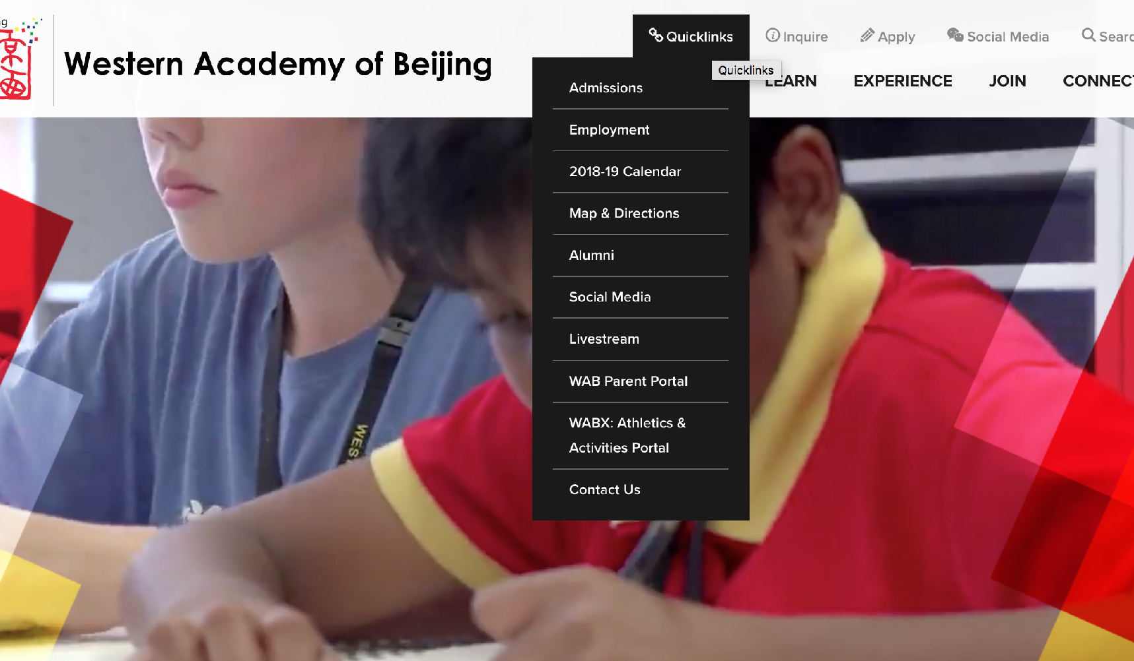
Easy to find the shop
Buy things
Can link to on-line store

Slide 12
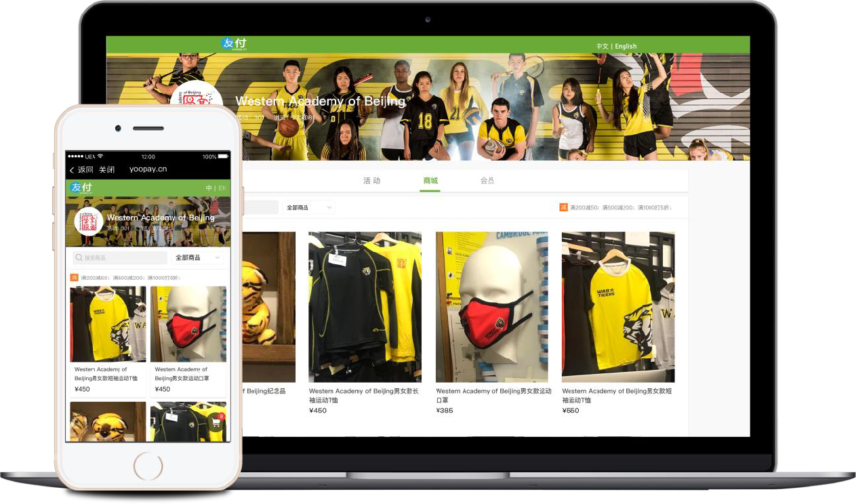
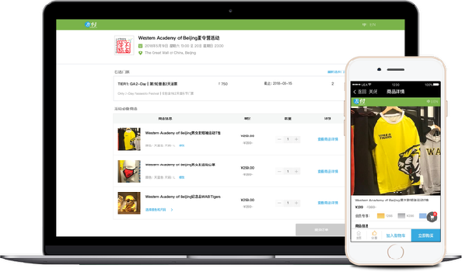
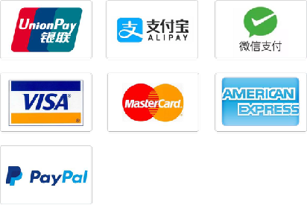
Internet shop http://wab.edu/shop
No programming necessary,
set up in 5 minutes.
Automatically optimized for both mobile and PC;
Powerful products promotion and management features.
Bi-Lingual.
Sell tickets & merchandise in multiple currencies
Design Once, Access on PC, Mobile & WeChat
Discretional pricing
(discount code, sales price, etc).

Slide 13
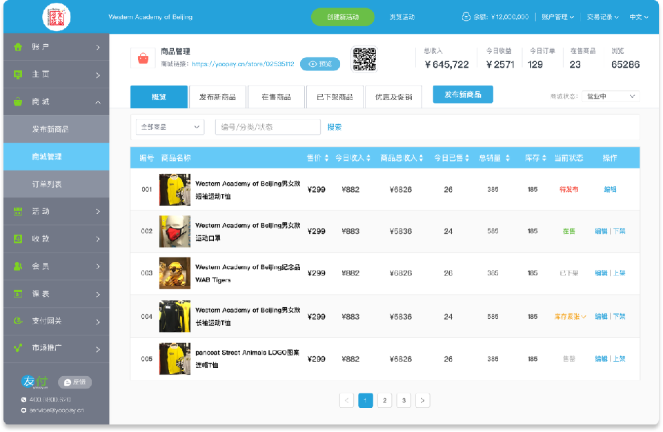
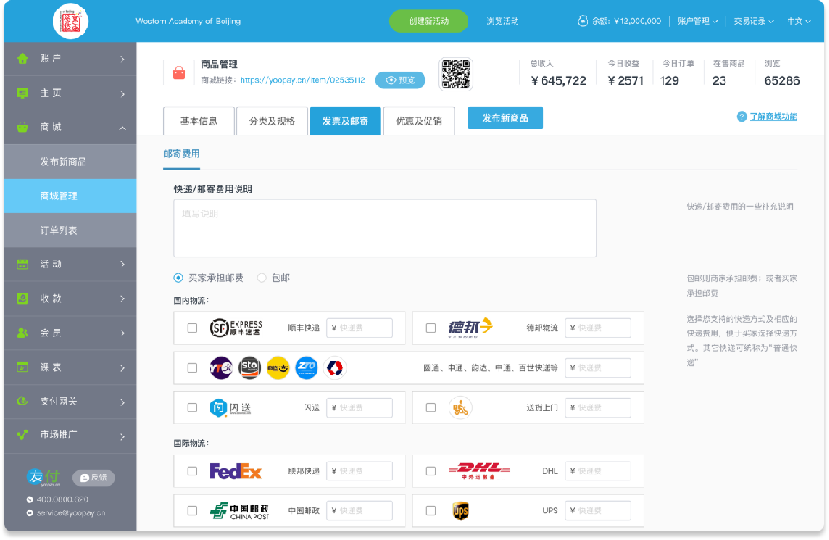
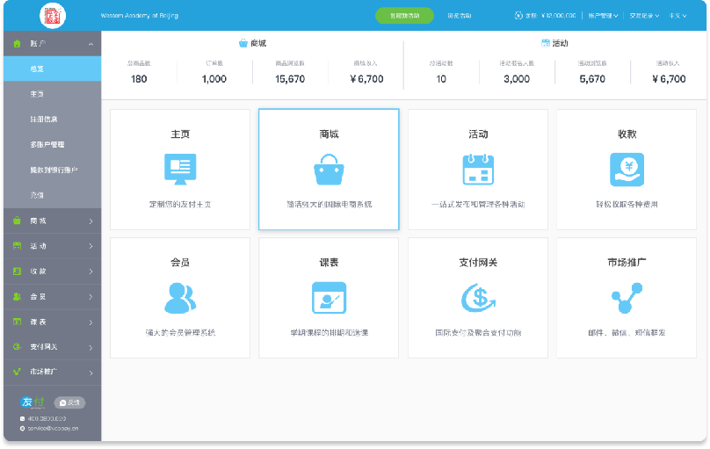
Inventory & logistics management
Merchandise, inventory, and catalogue management, discretional pricing (discount code, sales price, etc).
Integrating with delivery services & dashboard analytics

Slide 14
Merchandise Categories
Apparel
Art supplies
Food & beverage containers
Stationary
Souvenirs
Student developed products
Swim wear
Tickets
Technology supplies

Slide 15
Features to consider
Storefront:
Professional themes available
Mobile commerce ready
Ability to brand the store
Ease of maintenance
Inventory system
Payment system
Use of own domain name e.g. WAB.shop.
Store:
SSL encryption
Credit card & alternative payment gateways e.g. wechat/alipay/paypal
Language
Backroom:
Integrated with shipping
Tax calculation
Fapiao generation
Store management:
Customer profile
Customer account creation
Fulfilment centre connection
Refunds
Email templates
Order fulfilment
Marketing: SEO optimised
Generate Site map automatically
Discounts across the platform
Gift cards
Social media integration
Product reviews by customers
Email marketing integration
Product:
Inventory management
Product variants
Product organisation e.g. category
Multiple images per product
Digital product direct download
Import/export csv
Analytics:
Dashboard
Product reports

Slide 16
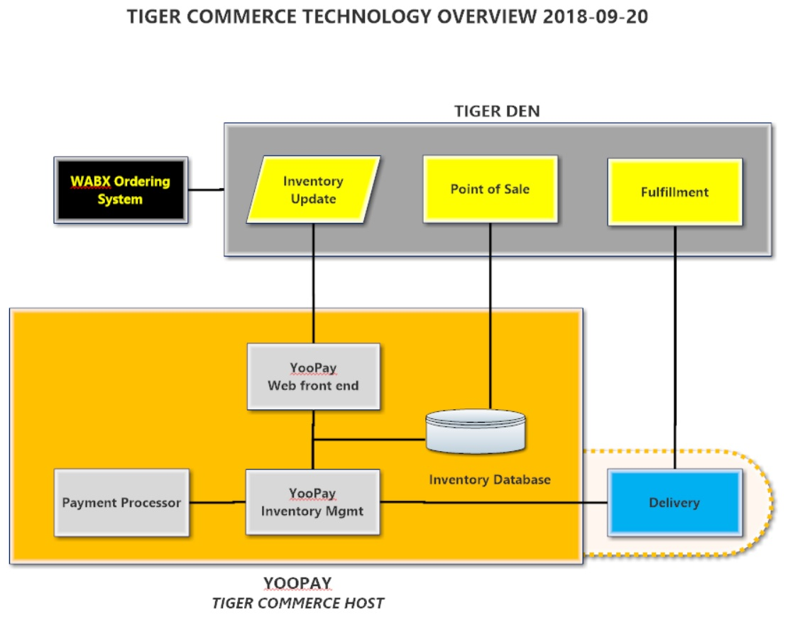
Technology overview

Slide 17
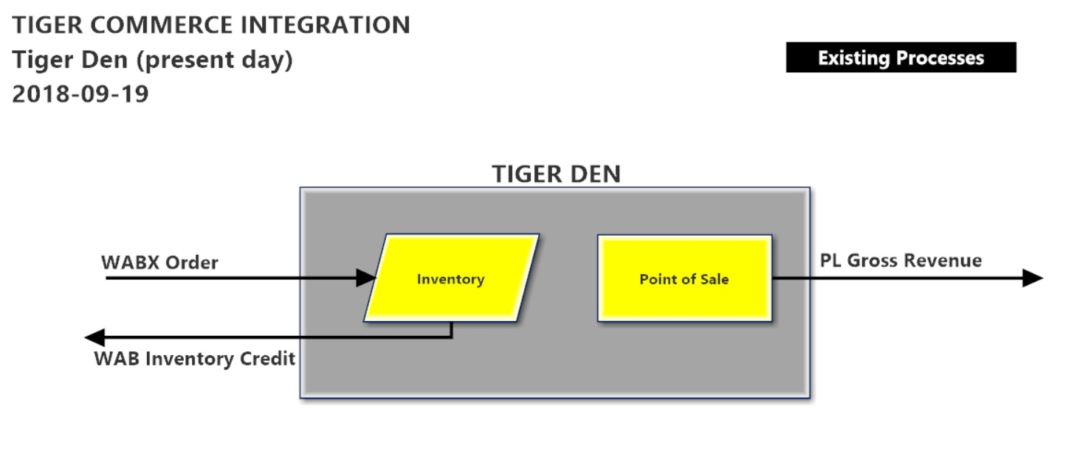
Technology process overview Tiger Den (before)

Slide 18
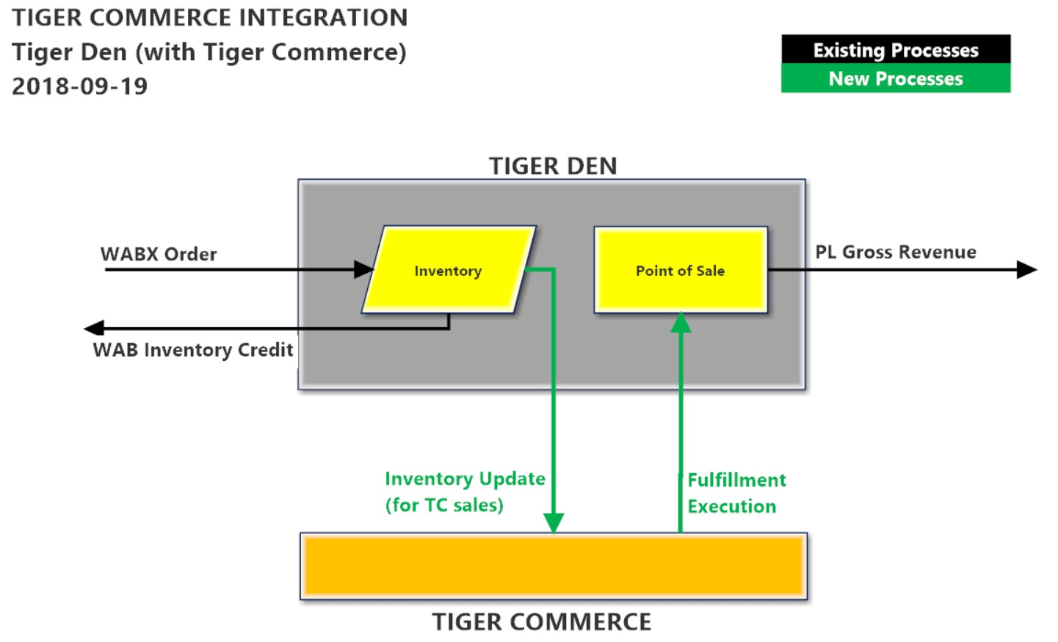
Technology process overview Tiger Den (after)

Slide 19
User Permission Profiles
Administrator / Superuser (WAB)
No restrictions
Fulfillment (PL & WAB)
Place order on behalf of another
Modify an order status (e.g. Order Received → Order Complete)
Accept cash payment and apply “Payment Received” status
Finance (WAB)
Pull store data (sales, product list, costs, etc.)

Slide 20
5. Legal
Parent Link runs the shop and future online sales of WAB Tiger Merchandise.
Parent Link does not have a legal entity.
WAB has to apply for the necessary licenses, bank accounts and legal documents.
WAB has to approve this project.

Slide 21
Business model
The Tiger Den will buy products from various suppliers, and charge a standard 100% gross margin. Discounts can be offered on items and at times of year to encourage purchasing. The goal is to standardise and improve margins to provide funds for reinvestment.
Sample model
Items | Cost Price | Sale Price | Gross Margin
Duffle Bags | CN¥210 | CN¥420 | CN¥210
Big Nike Back Pack | CN¥190 | CN¥380 | CN¥190
Tracksuit top | CN¥180 | CN¥360 | CN¥180
Track suit bottoms | CN¥110 | CN¥220 | CN¥110
Long Sleeve warmup | CN¥80 | CN¥160 | CN¥80
Tiger Hats | CN¥60 | CN¥120 | CN¥60
Socks | CN¥35 | CN¥70 | CN¥35

Slide 22
6. Finance
Assume 1,000 families spend on average RMB150 per year per child in year one, and that we can increase revenue per family, and increase the number of families buying.

Slide 23
Suppliers
The Tiger Den has a number of suppliers, some internal and a few external.
WABX
Marketing

Slide 24
Cash Flows
Funds pass to WAB Accounting
Tiger Den sells goods in the shop or online.
Surplus funds for Parent Link
WAB pays suppliers

Slide 25


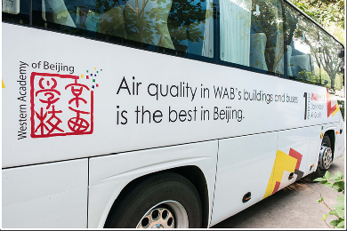

7. Promotion / marketing
Promotion of the store will be done via:
Tiger Den
Signage at MS & HS
WAB weekly
Print advertising
WAB events
Social media
Bus signage (1,000 journeys each day?)
Instagram 1,290 followers
Facebook 3,444 followers
Twitter 815 followers Youtube 225
LinkedIn 2,092 followers (n.b. not in the website dashboard.
WeChat?
Scan for WAB

Slide 26
8. Workflow
A) Ordering
B) Suppliers
C) Fulfillment
D) Maintenance / Recurring
WAB
PL

Slide 27




8. Workflow : Order Received
Precondition A buyer wants to place an order.
Postcondition An order is received.
Item
Purchased
Tiger Den
Add to Fulfillment List
Printed Fulfillment
Order
Generate Fulfillment Request
Fulfillment Request
Buyer
Tiger Commerce

Slide 28
8. Workflow
B1) Suppliers (shop delivery)
Determine deficit item(s) and amounts
Check stock inventory
Order the items from supplier, i.e. WABX
Check correct delivery
Stock
(shop and storage)

Slide 29
8. Workflow
B2) Suppliers (direct shipment)
Give supplier detailed order information
Check correct delivery via track &trace
Check order

Slide 30



8. Workflow : Order Fulfillment
Precondition An order has been placed.
Postcondition An order is ready for pickup.
Printed
Fulfillment
Order
“Order Fulfilled”
Retrieve
Item
Update
Fulfillment
Status
Printed
Fulfillment
Order
Place Order and Item in
Pickup Tray
Tiger Den

Slide 31
8. Workflow : Maintenance (WAB only)
Precondition Online store
Postcondition Accounting information pulled.
Precondition Online store
Postcondition Records queried.
Precondition Online store
Postcondition Site software updated and system is live.
Precondition Online store
Postcondition User added, removed, modified.

Slide 32
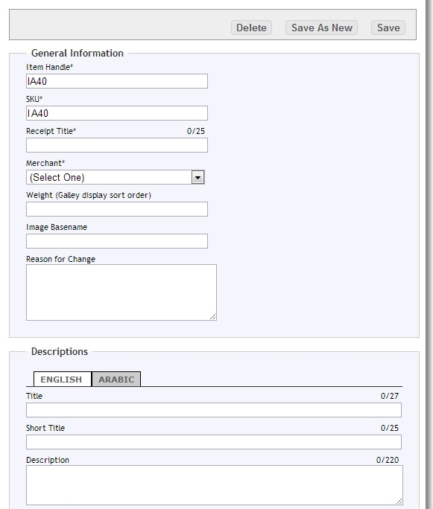


8. Workflow : Maintenance (PL & WAB)
Precondition A new product is received.
Postcondition New product is available online.
ID
Image
Description
Cost
VAT
Product Information Sheet
Enter product details and price into online system
Tiger Commerce

Slide 33
Timeline
 | Phase I | Phase II | Phase III | Phase IV | Phase V | Phase VI
Planning | August
Agree Implementation | Sept
Approvals |  | Sept | Oct | Oct | Nov
Catalogue of merchandise | August | Sept
Selection of technology platform |  |  | Sept
Photography of merchandise |  | Sept | Sept | Oct
Upload of content |  |  |  | Oct
Design storefront |  |  | Sept | Oct
Trial purchases |  |  |  | Oct | Nov 4th
Connect to WAB site |  |  |  |  | Nov 11th
Soft Launch |  |  |  |  | Nov 25th
Full Launch |  |  |  |  |  | Dec 1st

Slide 34
(no order of preference)
Jim James - jimajames@icloud.com
Victor Wang - omnivic@gmail.com
Rob Hackett - rob@thaxra.com
Michael Christiansen - michael_christiansen@wab.edu
COO/CFO at WAB
Raja Magasweran - raja@america-china.com
Jesper Køpke – j.kobke@outlook.dk.
Henk Vermeulen - hcv@hcv-advies.nl

Slide 35
WAB Tiger Commerce
WAB DAD| Parent Link Project 2018/19
Jim James
jimajames@icloud.com
Issue: 12.09.2018 v5

